Slide 1
GRAPH BASED MOVIE RECOMMENDATION SYSTEM
Team Members:
Eshikha Polimetla (B23CS1053)
Penmetsa Navyasri (B23CS1052)
Prajna Agrawal (B23CS1054)

Slide 2
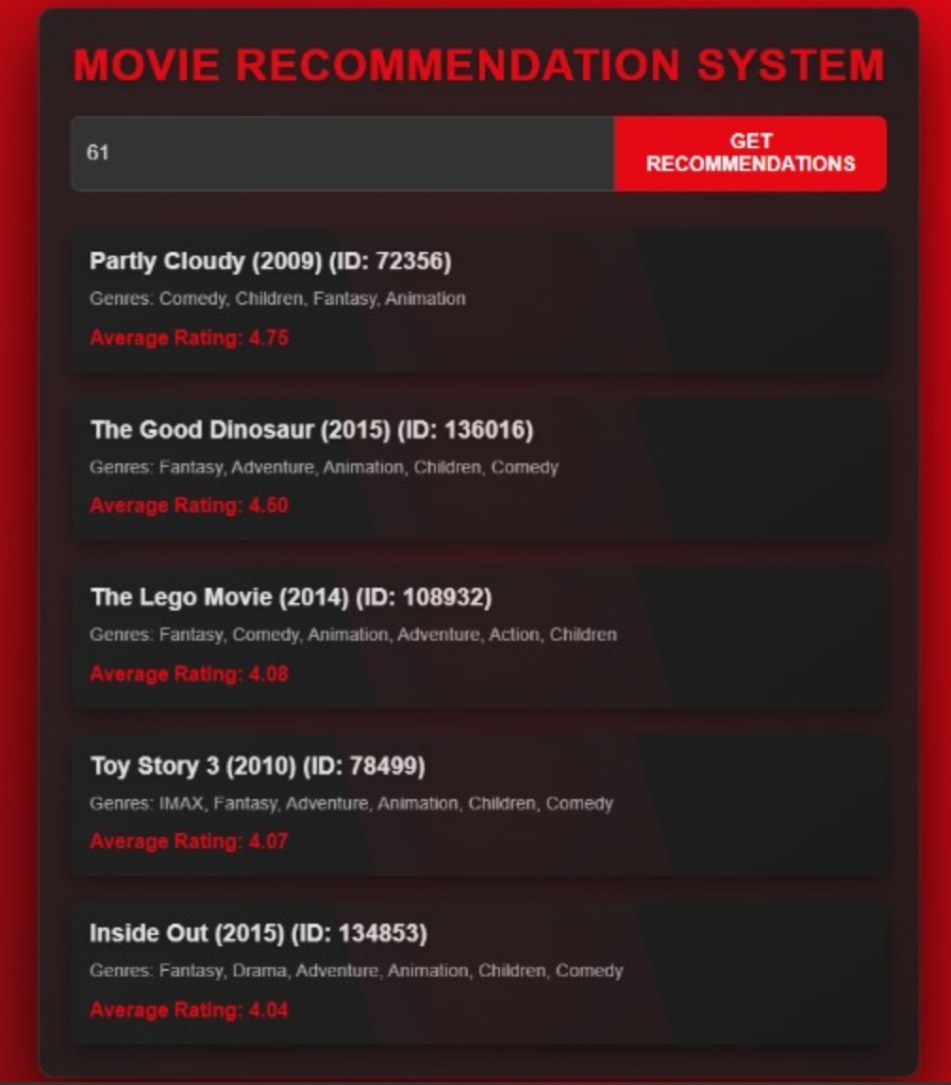
OBJECTIVE :
The primary objective of the Graph-Based Movie Recommendation System is to provide personalized movie recommendations to users based on their previous viewing history and genre preferences. By using a graph
structure to represent relationships between users and movies, the system aims to recommend the top
five rated movies that align with the user's interests.
OVERVIEW OF THE PROJECT :
The project utilizes a bipartite graph to model the interactions between users and movies.
In this graph :
Vertices represent users and movies. Edges represent the ratings given by users to movies,
with weights indicating the rating values.
A Bipartite Graph class is implemented to manage relationships between users and movies .
It maintains adjacency lists for user-to-movie and movie-to-user mappings, as well as data structures to store total ratings, count of ratings, genres, and titles for each
movie.

Slide 3
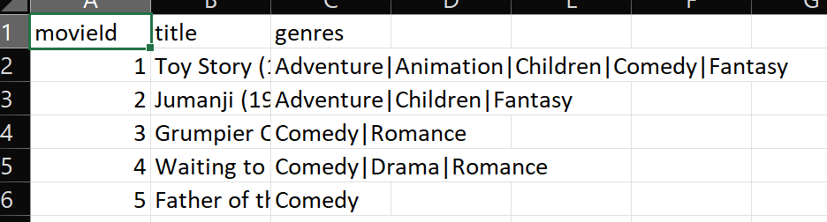
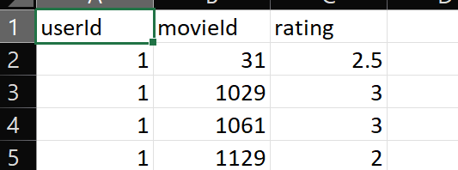
2. Input Handling: To create the graph with edges that indicate user ratings for different films, the system reads user reviews and movie information from CSV files.
3. Genre Preference Analysis: Using information from previously viewed films, the system determines each user's preferred genre. Genre frequencies from the user's rated films are combined to achieve this .
4. Similarity Calculation: To determine how well a movie's genre profile fits a user's tastes, the system uses cosine similarity. This makes it possible to find films that complement the user's prior preferences.
5. Recommendation Logic: The system ranks films based on their average ratings after identifying comparable films based on genre preferences.
And it recommends the top five rated films from this pool of comparable options.
Datasets Used:
For Movies- A data set of 9126 movies each having a unique MovieID, Movie Title and the Genres.
For Rating- The MovieId and the userId of the user who has rated it and the rating given.

Slide 4
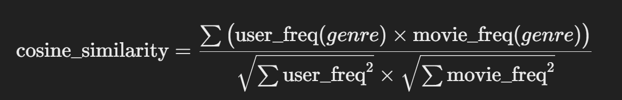
Algorithms used for implementation
In this code, content-based collaborative filtering is applied by using movie genres as the key feature to find similarities between movies. The cosineSimilarity() function calculates the similarity between a user's preferred genres (based on their movie ratings) and other movies' genres. Movies with similar genre profiles to those the user has rated highly are considered relevant. The findTopSimilarMovies() function ranks movies by their genre similarity to the user's preferences. Finally, the top-rated similar movies are recommended based on this genre-based similarity.
Cosine Similarity:
The cosine similarity algorithm is used to measure the similarity between the genres of a user's rated movies and the genres of other movies. It calculates how similar the user's genre preferences are to the genres of each movie.
Purpose: This is used in the findTopSimilarMovies function to rank movies based on how similar their genres are to the genres of the movies rated by the user. The more similar the genre profile of a movie is to the user's genre profile, the higher the cosine similarity score.
2. Content Based Collaborative Filtering:
Content collaborative filtering is applied by using movie genres as the key feature to find similarities between movies. The cosineSimilarity() function calculates the similarity between a user's preferred genres and other movies' genres. Movies with similar genre profiles to those the user has rated highly are considered relevant. The findTopSimilarMovies() function ranks movies by their genre similarity to the user's preferences. And, the top-rated similar movies are recommended based on this genre-based similarity.

Slide 5
How Do these Algorithms work Together ?
Step 1: User’s rated movies are used to calculate the genre frequency vector (getUserGenreFrequencies()).
Step 2: Cosine similarity is computed between the user’s genre profile and each movie’s genre profile (cosineSimilarity()).
Step 3: Movies are ranked based on similarity scores, and top similar movies are selected (findTopSimilarMovies()).
Step 4: For each similar movie, the average rating is computed, and movies are sorted by both similarity and rating (findTopRatedSimilarMovies()).
Step 5: The top 5 recommended movies are displayed to the user.

Slide 6
Thank you

